Slide 1





in partnership with
BSA logo, trade dress of Scouts BSA uniforms & the emblems & badges of rank thereon are trademarks of the Boy Scouts of America. Used with permission.

Slide 2


WE’RE IN THIS TOGETHER
2021 is an unprecedented year in the lives of our Scouting families as we continue to recover from COVID-19. As we look ahead, the most important goal is keeping everyone safe and healthy at all times.
This year’s popcorn sale will look and feel different for many of us. But your Council and CAMP MASTERS are dedicated to supporting you every step of the way. We are continually evaluating the current environment and recommendations with the best interests of everyone in mind. As the popcorn sale nears, we ask that you reach out to your Council regarding best practices and local safety guidelines.
As our Country takes the beginning steps towards recovery, we must continue moving forward as well. We need a united mindset focused on adaptability and resilience to keep the popcorn sale a vital part of funding your Scouting program in the coming year.
We hope this guidebook provides a step-by-step approach to setting your Unit up for popcorn sale success.
In 2021 CAMP MASTERS is providing all Councils and Units with training and marketing resources. Some information on these resources is included in this guide. And you’ll gain access to others over the coming months leading up to the sale.
However, if there is anything you need to help fuel your popcorn success, please don’t hesitate to reach out. Give us a call at 800.624.2060 or email our great team for assistance: customerservice@campmasters.org.
We are fully invested in your popcorn success!
Warm Regards,
Wilfred Sieg, Jr.
President

Slide 3

CONTENTS
Letter from CAMPMASTERS 2
Learn with popcorn 4
Important Contacts 5
2021 Product 6
Lead Your Unit 7
Kernel Checklist 8
How Much Popcorn to Sell 10
Annual Program planner 11
Commission and Prizes 12
Register Your Scouts 13-16
Storefront Recruiting 17
Popcorn Calendar 18
Popcorn Policies 19
Show-N-Sell Scheduling 20
COVID 19 GUIDELINES 21
Ordering Inventory 22
Your Popcorn Kickoff 23
CAMPMASTERS APP 24-28
Inventory & Payment 29
That’s a Wrap 30

Slide 4
LEARN WITH POPCORN
You’ve likely heard many times that “it’s not about selling popcorn, it’s supporting Scouting.” But what does this mean? And how does it impact each individual Scout?
Scouting is here to help children become ethical adults that make good decisions. And popcorn serves an important role in this mentorship. It's a learning activity, just like any other, designed to build important skills towards this goal. Specifically:
Association with Adults
Kids are sometimes shy or fearful around adults, even ones they know. For most, this doesn’t resolve itself as they age. They gain the opportunity for exposure and practice communicating with adults by participating in the popcorn sale. They build the confidence that will make future things like college essays, job interviews and talking to their boss so much easier. It sounds like a simple interaction, but it’s a way for them to overcome a tough barrier and learn how to navigate an adult-run world.
Salesmanship and Entrepreneurship
Learning to set and reach goals through action helps Scouts develop important business skills. They learn how to best represent themselves and persuade others. In the future, they can use these tools to gain funding for a revolutionary business idea or be a strong team leader within their organization.
Grow and Sustain Scouting
Scouting is not just an activity, but also a future career path. The mission of the organization needs strong leaders to carry the mentorship and impact forward into future generations. Everything they learn by participating prepares them to teach others what they know in Scouting or whatever future career they choose. Popcorn also brings Scouting to the attention of many others who may not be familiar with all that Scouting has to offer.
Fund Membership and Activities
And of course, popcorn funds all the amazing activities in their Scouting program.

Slide 5
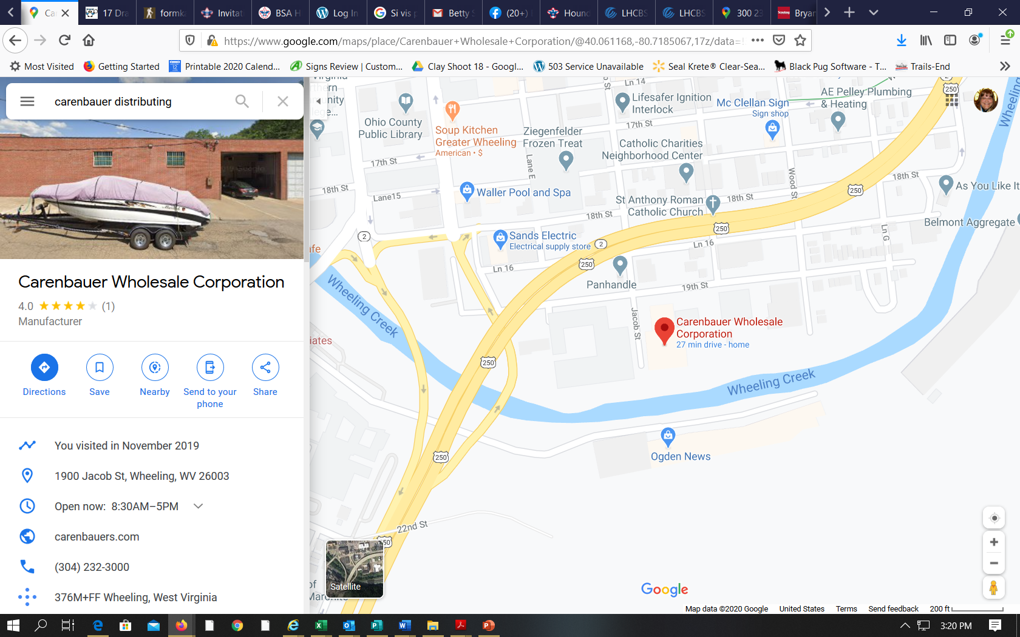
IMPORTANT CONTACTS
ORVC-BSA Contacts
Melissa Reinbold
Staff Kernel
740.827.4558
Melissa.Reinbold@scouting.org
Lori Abraham
Popcorn Specialist
740.275.1099
Lori.Abraham@scouting.org
Directions:
From the North from I-70 proceed South on US-250 take the 16th Street Exit, continue on 16th street to Jacob Street turn left onto Jacob Street. Carenbauer is on the left.
From the South from US-250 North take the 18th Street exit Continue on 18th Street to Jacob Street turn right onto Jacob Street. Carenbauer is on the left.
District Contacts
Mountaineer
National Trail
Two Chiefs
Carolyn Clements
304.670.7535
carmikeclements@msn.com
WAREHOUSE
Carenbauer Distributing
1900 Jacob Street, Wheeling WV 26003

Slide 6
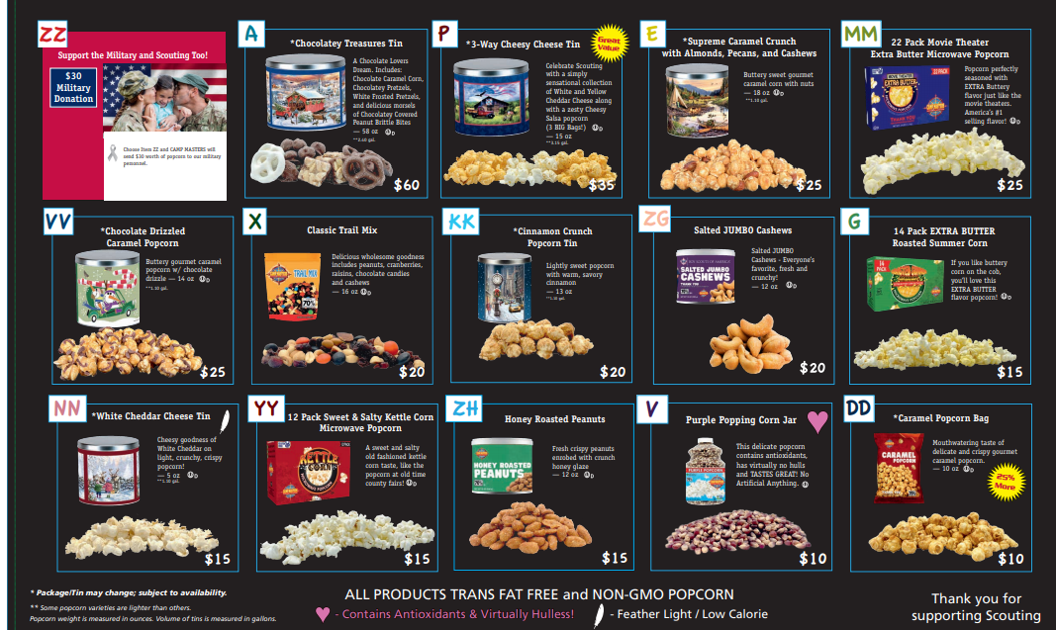
2021 PRODUCT SELECTIONS
INSERT PRODUCT MIX IMAGE HERE FOR YOUR COUNCIL
You’ll find this in your CAMP MASTERS folder
To pick up your popcorn, follow these
vehicle recommendations:
Midsize car holds about 20 cases
Luxury sized car holds about 40 cases
Minivan holds about 60 cases
Large SUV holds about 70 cases
Small Pickup bed holds about XX cases
Large Pickup bed holds about XX cases
Rental Truck holds over 70 cases
70 Cases
Over 70 Cases

Slide 7
LEADING YOUR UNIT
The Popcorn Kernel oversees operations of the Unit’s popcorn sale. This is an important leadership role within the Unit. The PK ensures distribution, promotion, reporting and payments for Unit’s entire sale period. They also work closely with their Unit committees and District Popcorn Kernel.
The best part is leading their #PopcornSquad in the Unit’s goals for the sale. This includes:
Encouraging Scouts to Earn Their Way
Developing the Overall Sale Strategy for the Unit
Establishing Relationships with Community Businesses
Helping Parents Support Their Scout
Guiding the Unit’s Progress to Their Sales Goal
Gathering and Distributing Important Information
Running Logistics for Product and Sales Earnings
Rewarding Scout Efforts with Great Prizes
and Hosting an EPIC Unit Kick-Off Celebration
Your #PopcornSquad includes (based on your Unit and District Size):
District Popcorn Kernel - Your right-hand in all things popcorn
Unit Committee Members - Helping you develop the plans and budgets
Assistant Popcorn Kernel - Your left-hand in all things popcorn
Kickoff Kernel - Your party planning partner
Show-N-Sell Kernel - Your logistics coordinator (preferably with a truck!)
Pickup Kernel - Your warehouse watchdog for product inventory
Prize Kernel - Your fun-lovin’ prize patrol buddy
Communications Kernel - Your social media / email master spreading popcorn love
As exciting as these position titles are, people tend to more receptive when asked to execute a specific task, not just serve a role in the popcorn sale. When asking for help, be sure to say what you specifically NEED help with and how much time you think it will take them.
For example, instead of: Hey Sarah, will you volunteer as Kickoff Kernel this year?
Ask: Hey Sarah, your creativity and crafting skills are top notch. Would you help me with decorations and games for the Popcorn Kickoff? I’m thinking it will take us about 5 hours in planning and decorating day of, plus whatever time you’d estimate for creating them.

Slide 8
KERNEL CHECKLIST
Attend Popcorn Trainings
Plan Annual Scout Program (w/ Unit Commitee)
Review Commission Structure & Prizes
Determine Additional Unit Prizes
Set Budget for Program
Recruit Your #PopcornSquad
Update Scout Roster (w/ Membership Chair)
Direct Scouts to Self-Register or Update Bio
Determine Per-Scout Fundraising Goal
Secure Storefronts (as / where possible)
Create Unit Timeline for Popcorn Sale
Establish Guidelines for Popcorn Pickup / Returns & Money
Confirm Show-N-Sell Locations & Times
Prepare / Update COVID-19 Guidelines
Place Unit Popcorn Order
Host Unit Kickoff Meeting
Prepare and Distribute Handouts
Share Tips & Ideas for Selling Popcorn
Provide Selling Incentives & Games for Scouts
Coordinate Pick-Up / Drop-Offs at District Warehouse
Encourage Scout & Parent Participation
Share Selling & Marketing Strategies
Help Scouts Share Their Online Selling Link
Place Final Popcorn Order
Order and Distribute Prizes
Remit Product Payments to Council
Contact District Kernel as Needed for Assistance
Celebrate!
My #PopcornSquad
District Kernel
Phone
Email
Assistant Kernel
Phone
Email
Kickoff Kernel
Phone
Email
Show-N-Sell Kernel
Phone
Email
Pickup Kernel
Phone
Email
Prize Kernel
Phone
Email
Communications Kernel
Phone
Email

Slide 9
POPCORN TRAINING
DATE | LOCATION | TIME | ATTENDEES
August 1 | Council Kick Off | 2-4pm | Popcorn Kernels-Top Sellers-Unit Leaders-Popcorn Sellers
August 9 | Two Chiefs Kick Off | 6:30 PM | Popcorn Kernels-Top Sellers-Unit Leaders
August 12 | National Trail Kick Off | 6:30pm | Popcorn Kernels-Top Sellers-Unit Leaders
August 17 | Mountaineer Kick off | 7:00PM | Popcorn Kernels-Top Sellers-Unit Leaders
TRAININGS AND MUCH MORE….Found on the following weblinks…
https://www,Campmasters.org
And all the How-to-Instructions
https://www.campmasters.org/how-to-order-popcorn
And don’t forget our website with helpful hints
http://orvc-bsa.org/popcorn/
Commission Structure
30% Base Sales Commission

Slide 10
HOW MUCH POPCORN TO SELL
The mission behind the unit program planning philosophy is to help Scouting units fulfill young people’s need for adventure and deliver on this promise. Units that operate under an annual program plan, that young people help construct, are proven to be more successful and make a more profound impact on the lives of their members. We promise young people the most exciting adventures they can imagine, and we had better be prepared to make it happen. How do you get buy-in and commitment from your unit’s families when it comes to annual programming and fundraising needs? Your answer to this question is the key factor to the level of success your Scouting program will enjoy.
Brainstorming Ideas to Get You Started - The unit might plan and fund some of the following:
Program Ideas: Other Considerations:
Summer Camp BSA Registrations & Scout Life Magazine
Cub Scout Council Events Meeting Supplies/Awards & Recognitions
Monthly Unit Activities Den/Patrol Expenses/Training Courses
Pinewood Derby Unit Equipment
Patrol/Den Activities Uniforms/Personal Camping Equipment
Assistance for Low-income Scout Families
Once there are several ideas under consideration, filter them to allow the most realistic ones to surface. Be cautious not to discount Scouts ideas. Do provide them with enough information to decide which are most in creating their best program year.
Next, add key dates to a unit calendar that will be shared with Scouts and parents. Be sure to account for vacations, holidays and other school functions.
You now know what you’re doing and when. It’s time to budget! You can use the planner to help you organize activities and determine your fundraising goal.
Scouting teaches Scouts to earn their way. And a organized popcorn sale helps them learn to plan and meet their goals. Studies show your Scouting families appreciate a well planned sale that helps them coordinate it within their already busy lives.
Show them how the Unit and Scout sales fund the planned activities within the program. Present them with a clear fundraising goal. And offer an approach that allows them to achieve their goal.
A little time spent organizing now, means more participation and success in the fall!

Slide 11
ANNUAL PROGRAM PLANNER
Involvement is key in the successful planning of your annual program. We recommend allowing Scouts and their families express their ideas during a Troop brainstorming session. The older the scout, the more benefit they get from participating in this planning. It also keeps everyone more engaged in the popcorn sale because they know the rewards of their efforts.
ACTIVITY | PROGRAM MONTH | COST
 |  | $
 |  | $
 |  | $
 |  | $
 |  | $
 |  | $
 |  | $
 |  | $
 |  | $
 |  | $
 |  | $
 |  | $
 |  | $
 |  | $
 |  | $
 |  | $
 |  | $
 |  | $
Registration & Insurance | $
Advancements | $
Uniforms | $
Scholarships | $
Other | $
TOTAL UNIT BUDGET | $
NOW CALCULATE YOUR POPCORN SALES GOALS
Divide UNIT BUDGET by UNIT COMMISION (This is your Unit Sales Goal) | $
Divide by NUMBER OF PARTICIPATING OF SCOUTS (This is your Scout Sales Goal) | $

Slide 12

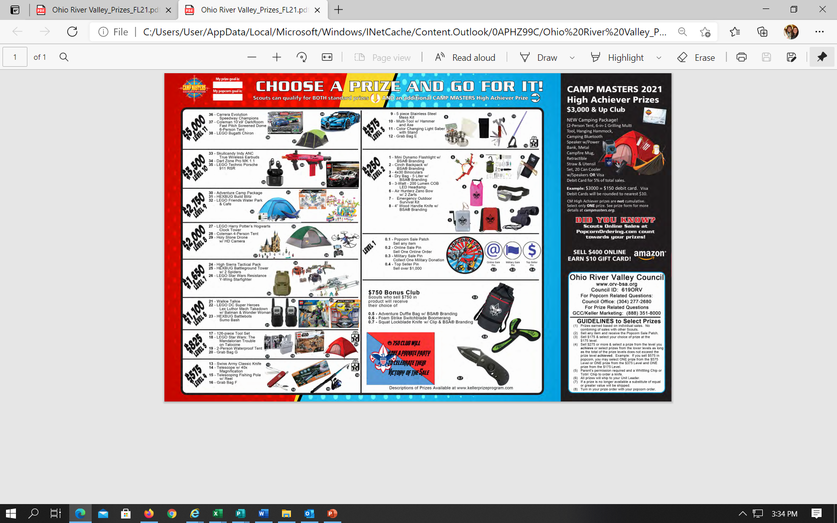

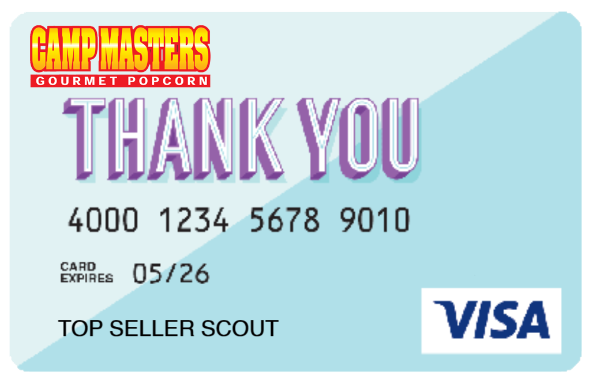
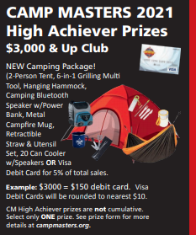
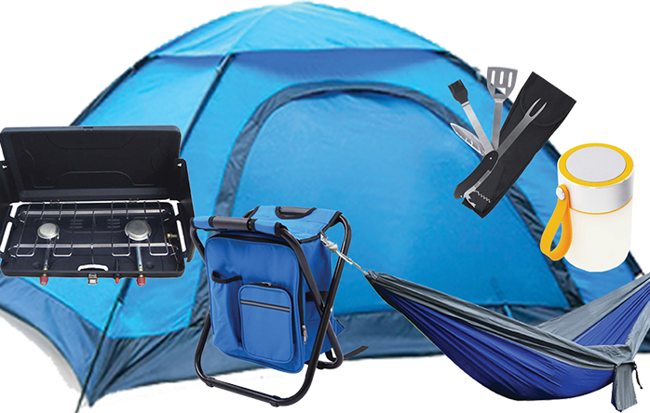
COMMISION & PRIZES
Commision structure for your Units plus any incentives you’re adding for sales, prizes, etc.
Email your sales rep for help in designing this page if needed.
IN ADDITION to these incentives, CAMP MASTERS offers High Achiever Prizes to recognize Scouts Popcorn Sale efforts.
SELL $400+ ONLINE
GET A $10 AMAZON GIFT CARD
SELL $3000+ TOTAL
GET 5% BACK ON A
VISA DEBIT CARD
OR THIS CAMPER PKG
Tent, Grilling set, Hammock, Cooler Chair Backpack, Camp Stove, Bluetooth Speaker & Lantern

Slide 13
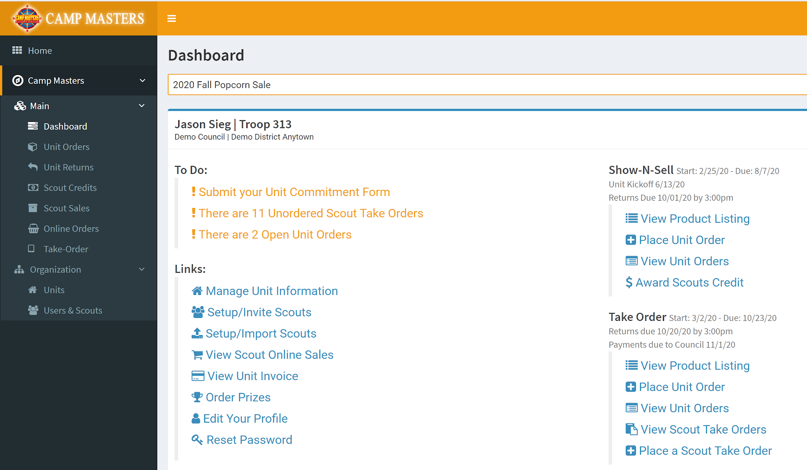
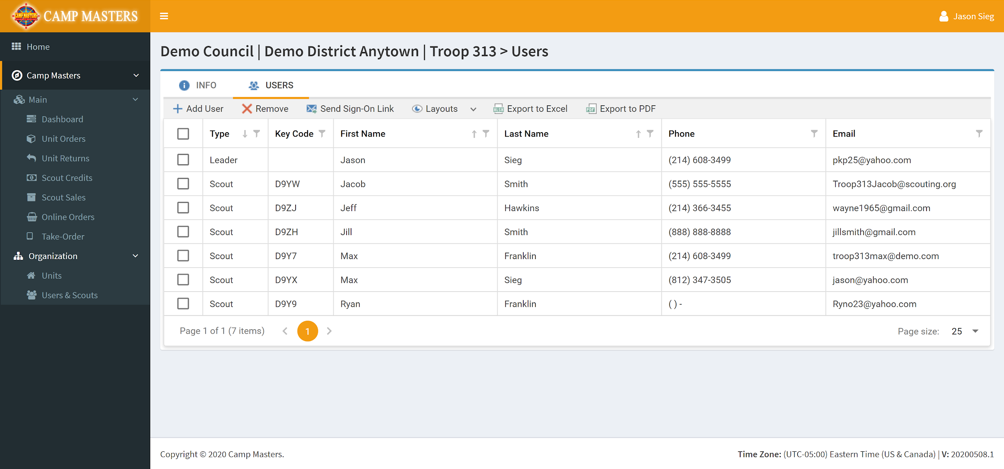
REGISTER YOUR SCOUTS
UNIT LEADERS: Scouts must be registered in the CAMP MASTERS system to receive sales!
Step One: Log in to the CAMP MASTERS system and click “Setup / Invite Scouts.
The list of current Scouts registered in your Unit will be displayed.

Slide 14
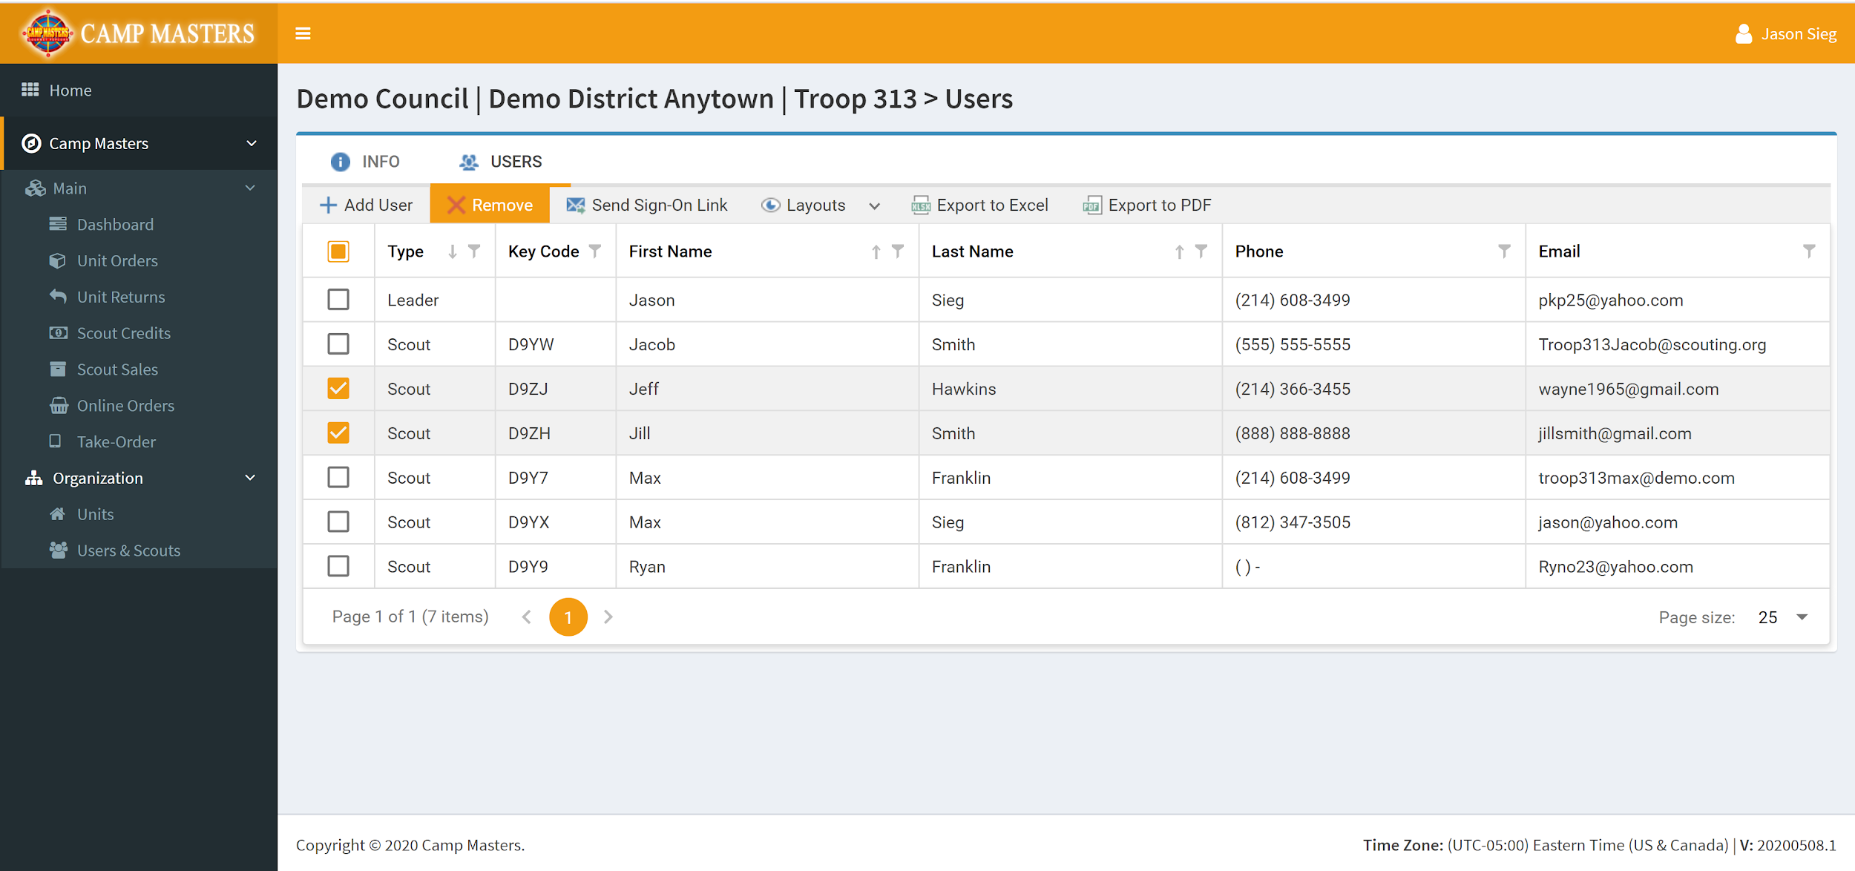
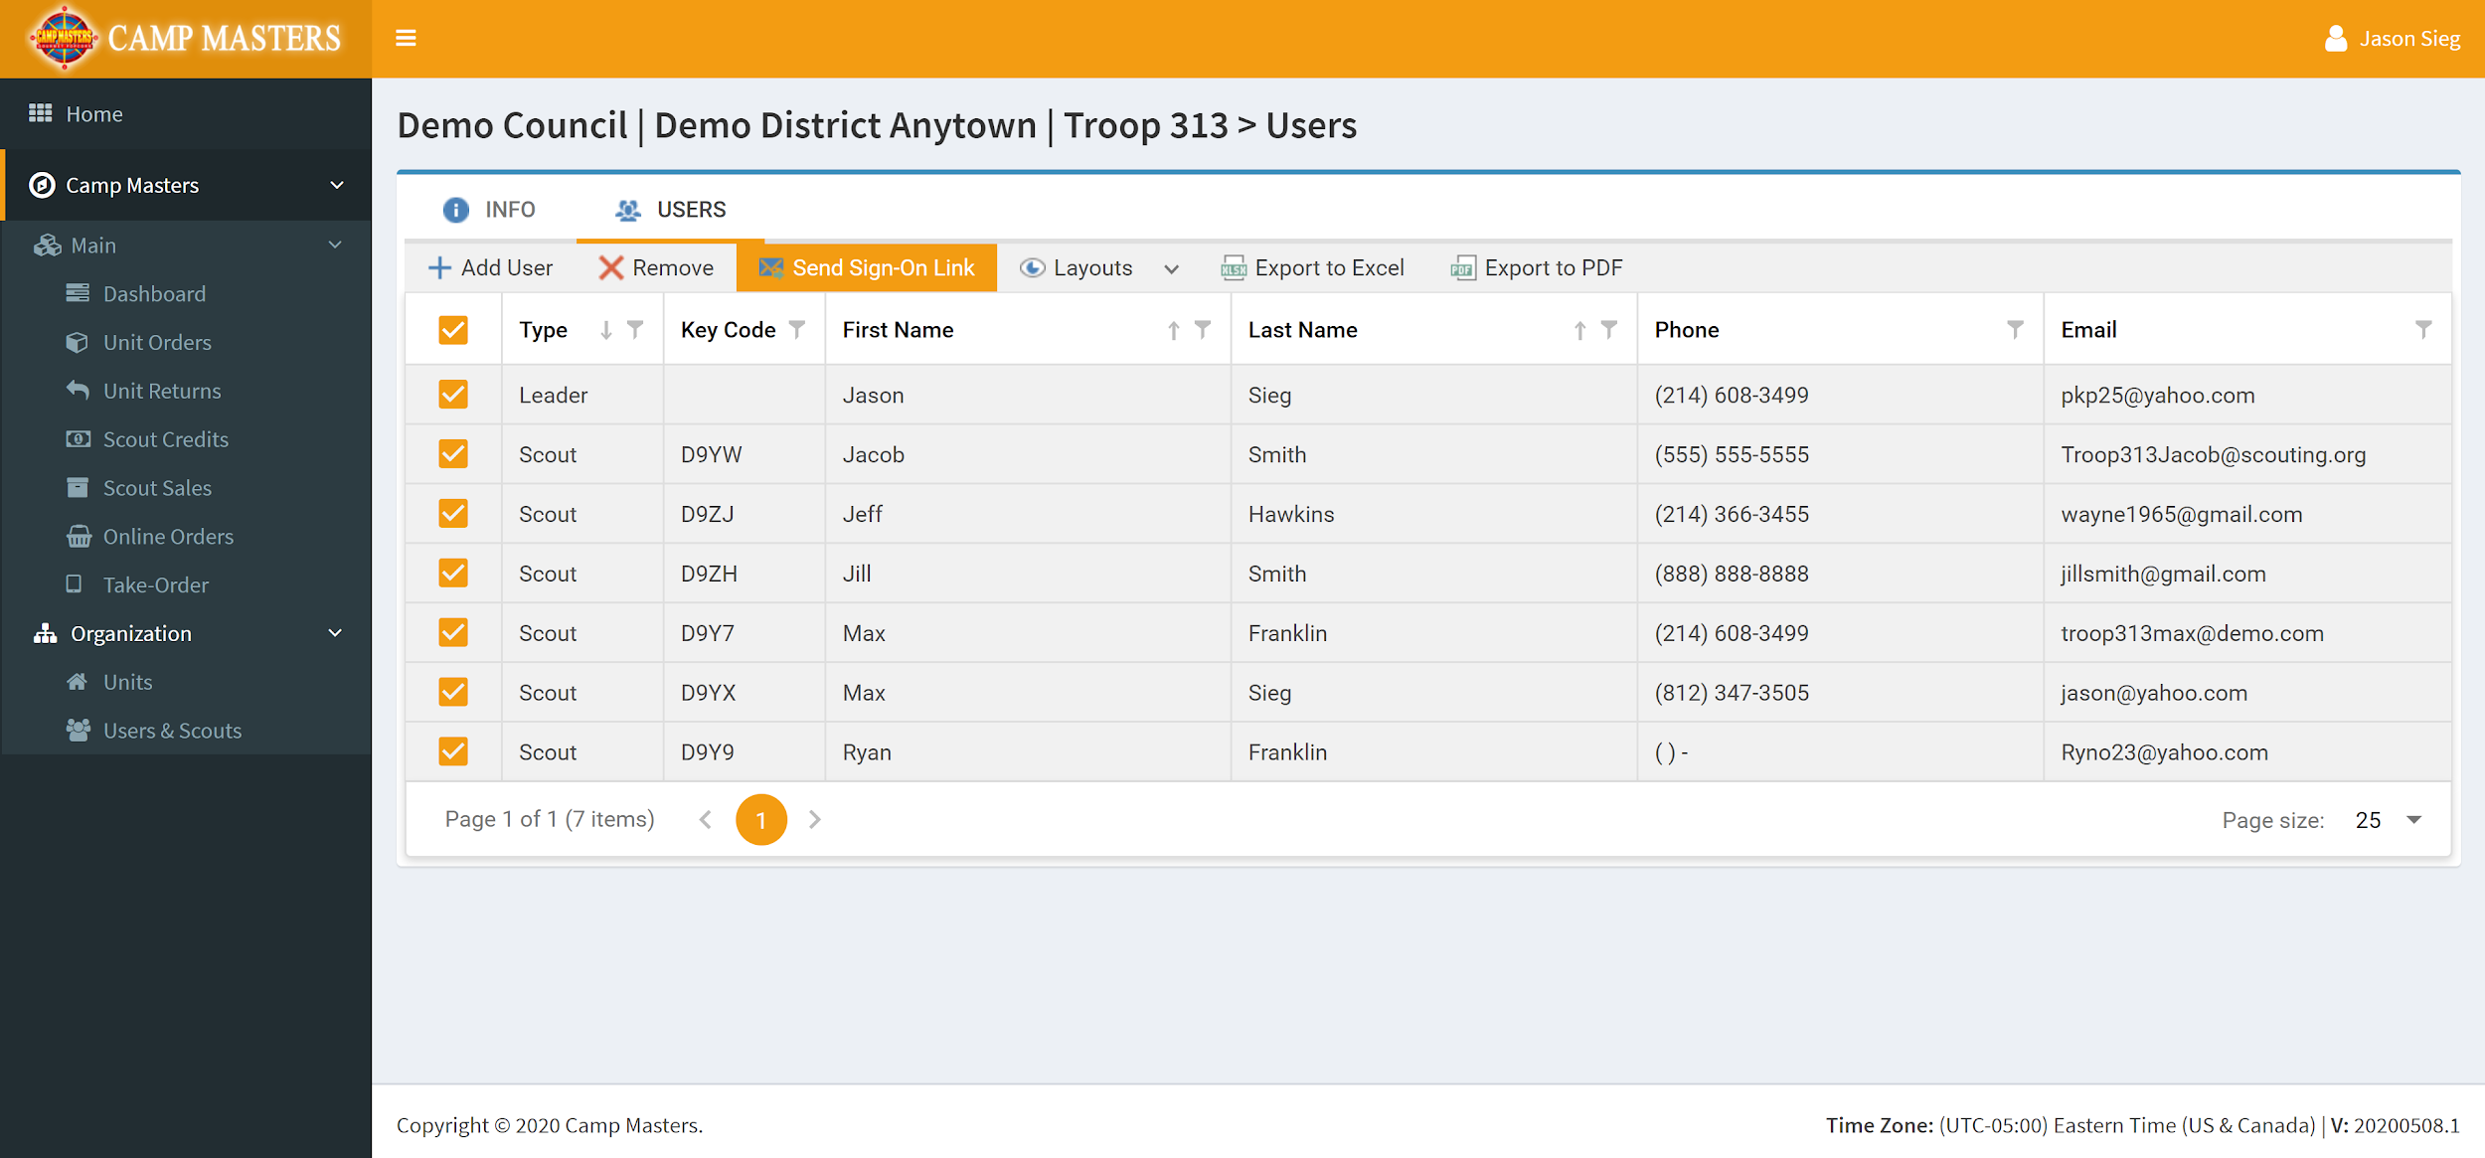
REGISTER YOUR SCOUTS
Step Two: Remove any Scouts no longer in your Unit by clicking the box to the left of their name(s). And then selecting “Remove” from the menu above.
Step Three: For the remaining Scouts, make sure their contact information is correct. Then select them by clicking the box to the left of their names. And then select “Send Sign-On Link”.
This will email each of the Scouts their unique CAMP MASTERS link so they can access the system without having to login. This makes taking orders and payments much easier.

Slide 15
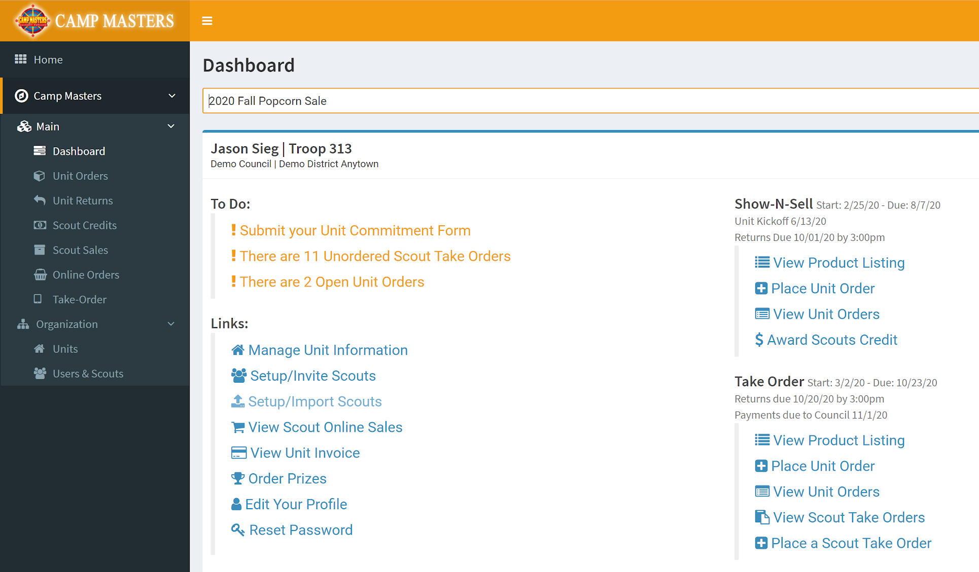
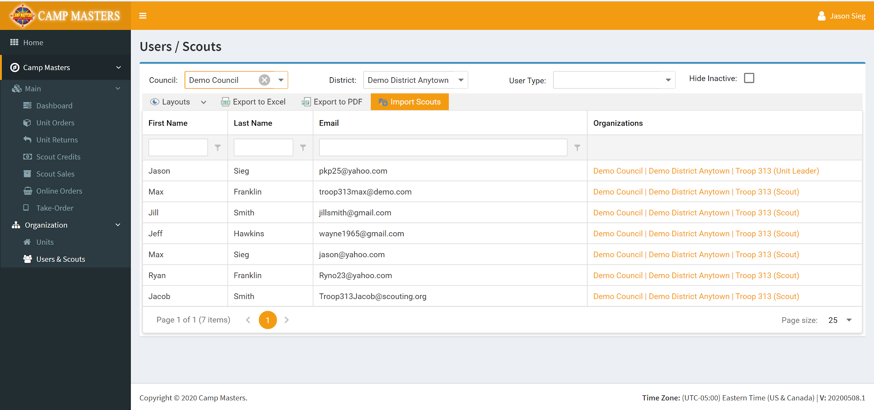
REGISTER YOUR SCOUTS
Step Four: For new Scouts, select the “Setup / Import Scouts” option from the dashboard.
Step Five: Click the “Import Scouts” button and upload your Excel spreadsheet.

Slide 16
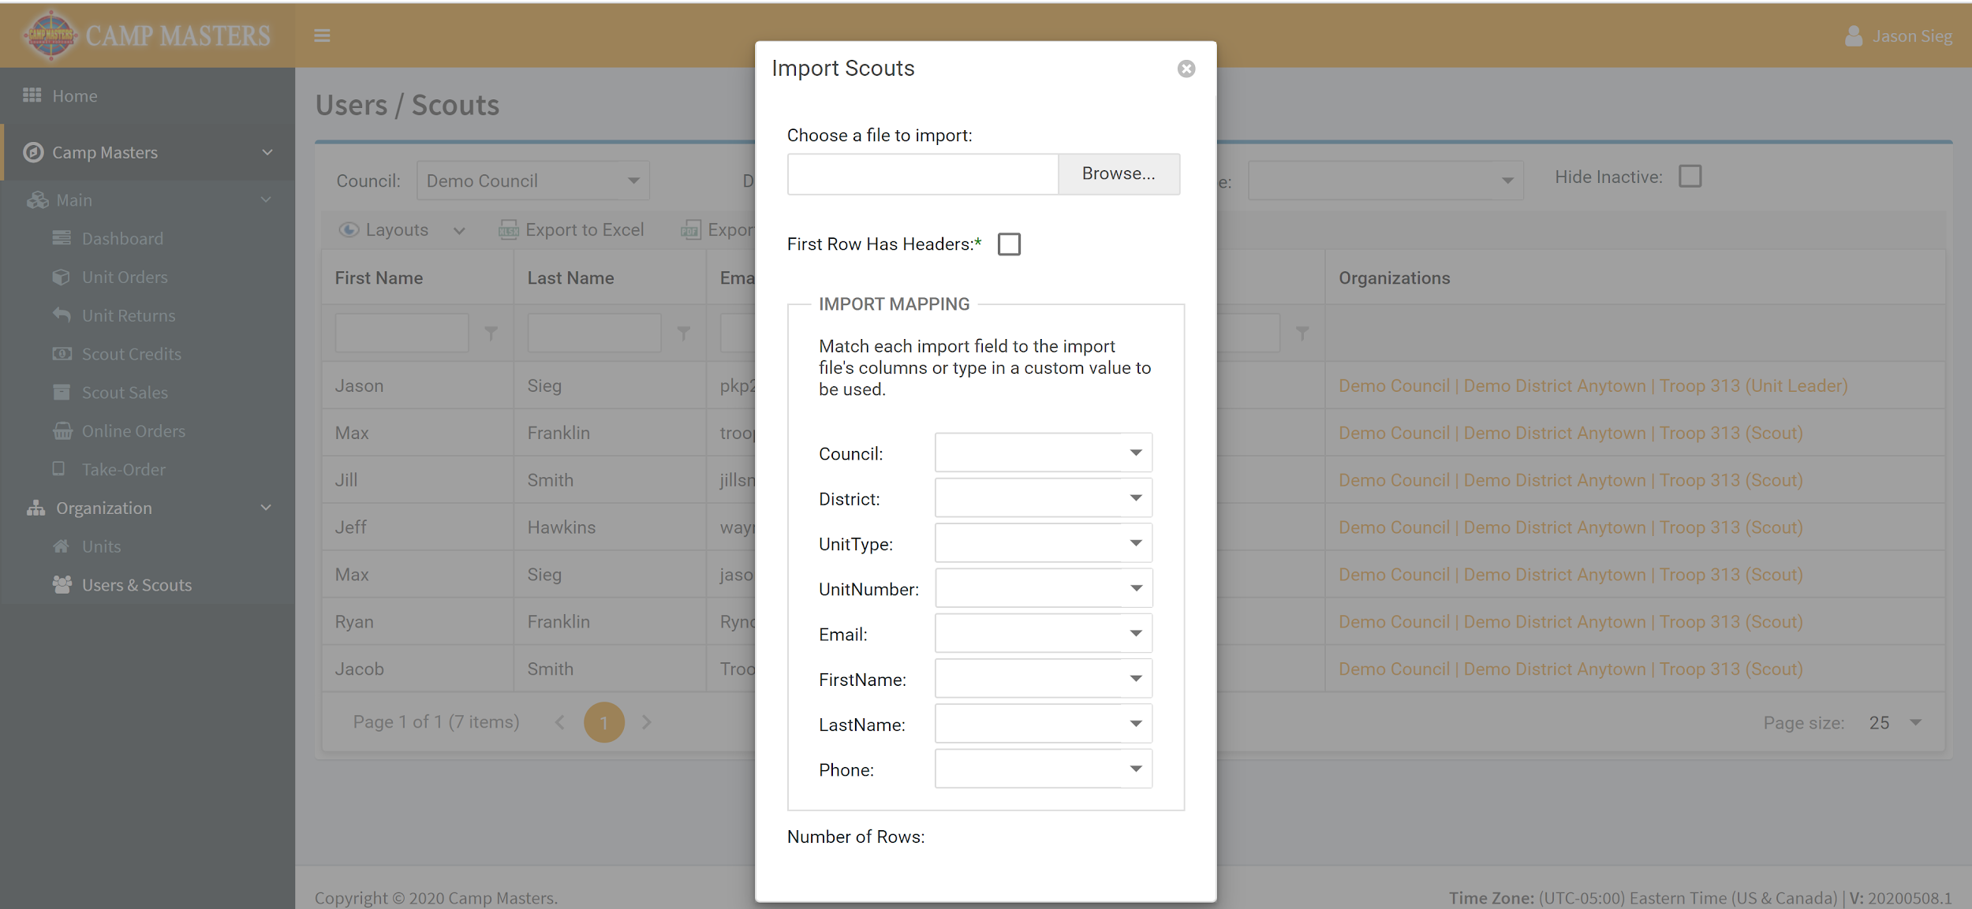
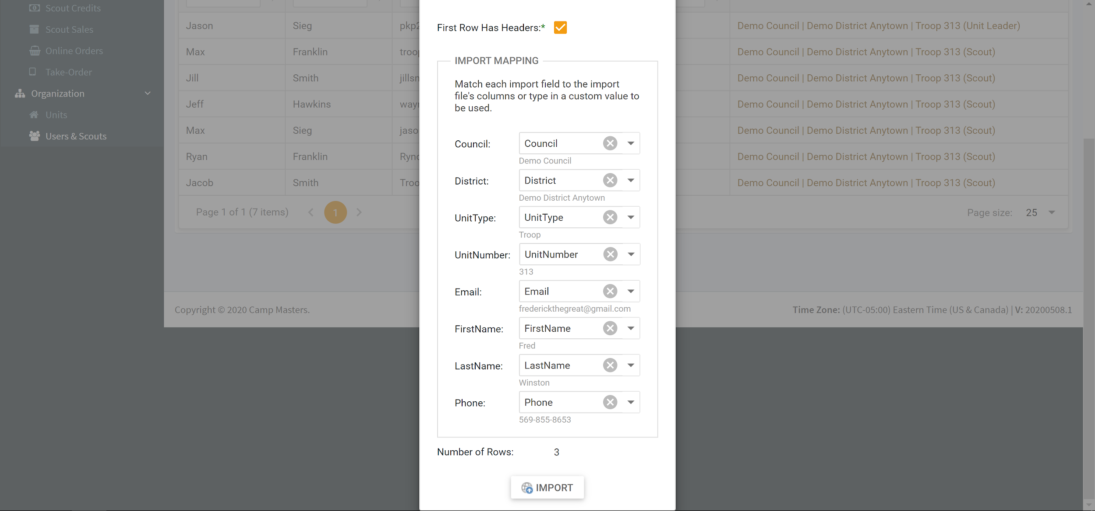
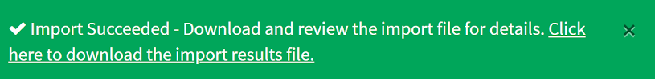
REGISTER YOUR SCOUTS
Step Six: Select your file and complete the field matches to the spreadsheet columns below. If you sheet has headers, be sure to select the “First Row Has Headers” box.
You’ll see a data preview as you assign each field for import. Once complete, click “Import”.
You’ll see a green success box once imported.
If you get an error, check your spreadsheet rows again carefully for typos.

Slide 17
STOREFRONT RECRUITING
You can never start too early in securing storefronts. Of course, it’s going to be a bit different this year. And that means adapting your approach. Here are some of the best tips to help you do just that:
Grocery stores and home improvement stores are both essential businesses. But they are receiving policies and procedures for Coronavirus from corporate. Make sure you approach the store/company Manager with this in mind. Do some research and find out the policies in place so you can adapt your approach and relate how Show-N-Sell will meet these guidelines.
Right now, resources are tapped thin in these stores. Consider sending an email or leaving a message for the Manager to call you back. The reality is, you’re not going to be their first priority right now. After a few attempts, and still no response, only then try going in person.
Think of other high-traffic, essential businesses in your area to contact. As other businesses begin reopening, reach out to them as well.
Use the COVID-19 recommendations in this guide to help the Manager/Owner understand that above all else, safety comes first. This will help ease their mind while it is still uncertain what the fall recommendations will be.
SAMPLE EMAIL / SCRIPT
Hello [NAME],
This is [YOUR NAME] from Scout Troop [Troop #]. Our Scouts are holding our annual popcorn fundraiser this year. The funds raised supports their ability to participate in our local Scouting program.
Due to the coronavirus, it’s going to look a lot different this year. However, with everyone’s safety guidelines in mind, I wanted to reach out regarding hosting a Show-N-Sell at {STORE NAME] in [MONTH].
Much can change between now and then, so I’m not looking for a definite answer today. What I’d like to do is confirm you’d consider it and then reach back out for a yes or no as the date draws closer.
Can I reach back out in [A MONTH, A FEW WEEKS?]?

Slide 18
2021 POPCORN SCHEDULE
2021 PopCorn ORDERS/SALES TimeLine:
Online Sales:
Begins Saturday, July 31 to Friday, December 31, 2021
Show and Sell Orders:
Wednesday, September 1, 2021—place order online
Wednesday, September 22, 2021—Show and Sell Pick Up at Carenbaurer's Warehouse
Show and Sell and Take Orders Begin Saturday, September 25, 2021
Show and Sell and Take Orders Ends Sunday, October 31, 2021
Take Orders:
Monday, November 1, 2021—place order online
Monday, November 1, 2021—All Show and Sell is returned-except popping corn
Prize Orders:
Monday, November 1, 2021—All Prize Orders are due
Wednesday, November 17, 2021—All Popcorn Money is DUE
Wednesday, November 17, 2021 —-Popcorn is Picked Up at Carenbaurer’s Warehouse
Sale Reminders:
• Only one popping corn can be ordered for show and sell and can not be returned.
• Damaged Popcorn Product: -Notify us immediately, not much we can do, and we can’t take it back—and we can’t give a credit if you wait to the end of the sale to tell us there was damaged product.
• BE SURE your scouts and Especially their parents know what unit they are in...Pack 87 or Troop 87 or Crew 87

Slide 19
POPCORN POLICIES
Unsold undamaged product is due in the scout office by Monday, November 1, 2021, before Noon.
Take Orders are due by 4:00pm Monday, November 1, 2021
NO UNSOLD PRODUCT WILL BE ACCEPTED AFTER NOVEMER 1, 2021!
Show N Sell Order Payments and Take Order Payment should be in before product pick up on Wednesday, November 17, 2021.

Slide 20
SHOW-N-SELL SCHEDULING
Locations will be added as locations become available.
DATE | LOCATION | SHIFTS | NEEDED ADULTS AND SCOUTS
Saturday Sunday | Store Front Location | 8 - 10 AM | Adult 1: Adult 2: Scout 1: Scout 2: Scout 3:
 |  | 10-Noon | Adult 1: Adult 2: Scout 1: Scout 2: Scout 3:
 |  | Noon-2PM | Adult 1: Adult 2: Scout 1: Scout 2: Scout 3:
 |  | 2-4 PM | Adult 1: Adult 2: Scout 1: Scout 2: Scout 3:

Slide 21
COVID-19 GUIDELINES
CAMP MASTERS is dedicated to the safety of our Leaders, scouts, Families & customers. As we prepare for the popcorn sale, it’s important that everyone operate in accordance with any restrictions outlined by your state and local health department or other state and local authorities. Be sure to check with your Council if you are unsure what’s required in your area.
When it comes to the products, we have implemented numerous safety protocols at our production, warehouse and fulfilment centers. This measure includes many of the guidelines recommended below. And we continue to evaluate the current environment in our local area.
Show-n-Sells are an exciting time for your Scouts. All the energy and enthusiasm of representing their pack within the community. CAMP MASTERS is offering the following guidelines to keep everyone safe this fall. These will be updated when necessary.
RECOMMENDED SHOW-N-SELL GUIDELINES
Reiterate before the event anyone exposed to Coronavirus should find an alternate person to take their place at the sale or contact the Popcorn Kernel.
Take everyone’s temperature before and/or at arrival to the store.
Everyone should wear masks and gloves to minimize the spread of germs. Watch this video to see how quickly they can spread.
No more than 3 kids and 2 adults should be at any single selling location.
Always wash your hands minimum of 20 seconds. (Refer back to the germ video).
Use hand sanitizer regularly, especially after customer transactions.
Clean surfaces frequently with a disinfectant wipe or hand sanitizer.
Assign one individual to handle all money transactions. And one to handle all popcorn.
Use Signs to help inform customers you’re fundraising and provide directions for safe interactions between Scouts and customers.
Do not shake hands with customers and maintain social distance to them as well as any other booth participants.
Do not have open food or drinks in the area. Do not share drinks, cups or utensils. There is high potential for spread of the virus to these items.
If you have to sneeze or cough do it away from the booth and other people. Remember to sneeze or cough into your elbow.
When possible, avoid engaging with anyone exhibiting symptoms.

Slide 22
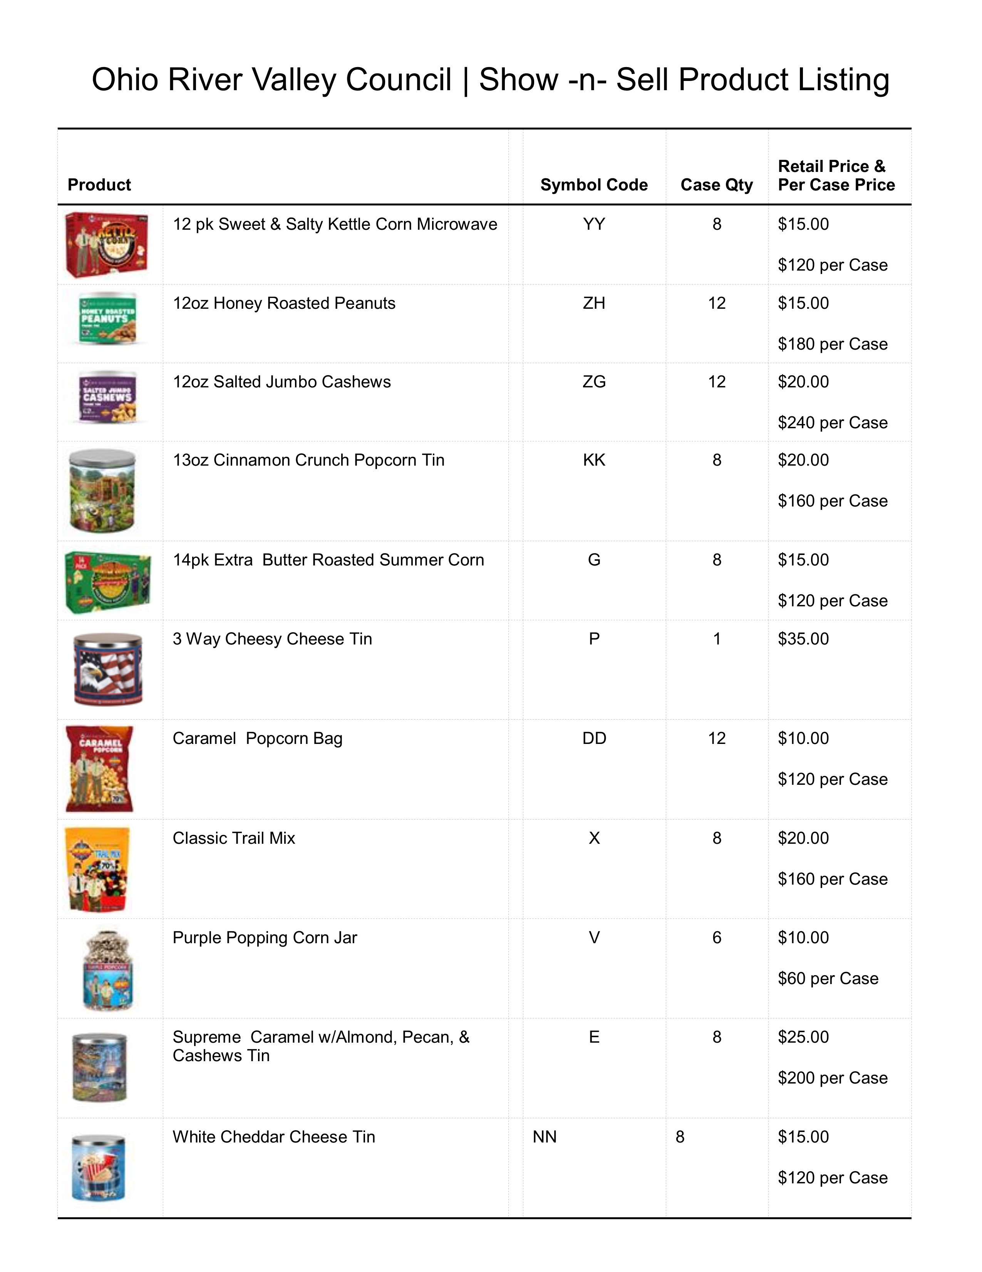
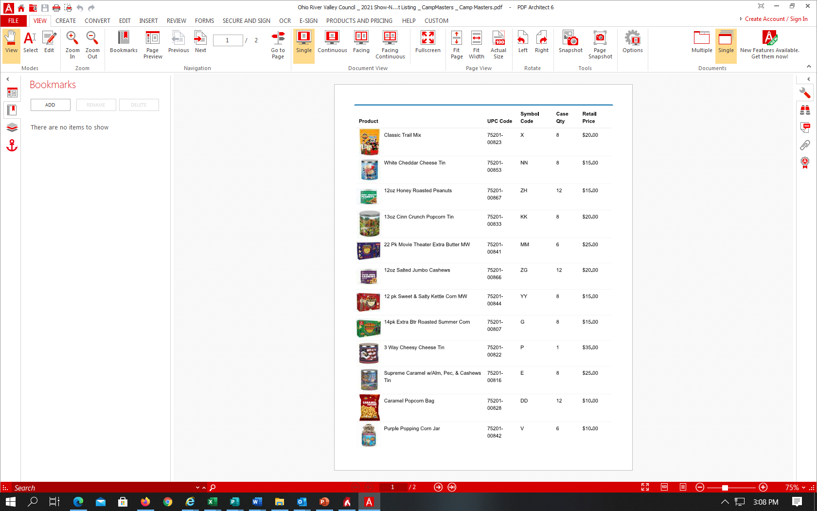
ORDERING INVENTORY
Contact Melissa or Lori at the Scout Office if you have any questions.

Slide 23

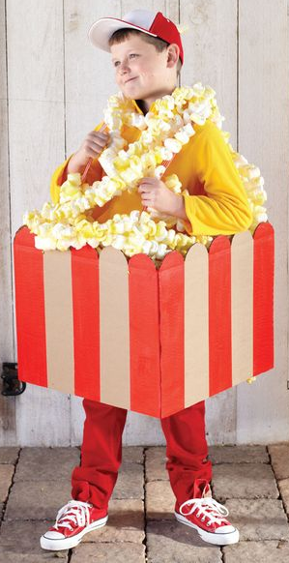


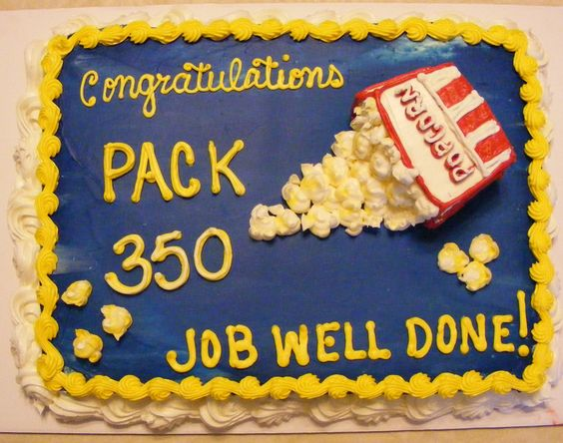
YOUR POPCORN KICKOFF
A great popcorn sale starts with a great popcorn kickoff! Follow these simple steps to start your popcorn sale with a BANG and motivate your Scouts, parents and other volunteers.
Set the Agenda. Think of things that are fun and fast-paced. This helps build energy and excitement for the popcorn sale. Scouts will leave ready to earn their way selling delicious popcorn!
Ask for Help. Enlist others to help you pull off a fun and exciting popcorn kickoff! No need to try and take it all on yourself.
Know Your WHY. Share the exciting Scouting Program that this fundraiser will support. Talk about the activities and what the Scouts will experience. And reiterate that it can all be paid for by POPCORN! (See pg 4 for additional info to share.)
Review the Forms. Show Scouts the forms they’ll be using in detail so they understand how to use them to promote the products and capture orders.
Build their Profile. Have each Scout register or update their profile at CAMPMASTERS.org.
Ready to Sell! Add CAMP MASTERS to their phones.
Sharing is Caring. Explain how they can share their CAMP MASTERS profile link with friends, family and through social media.
Cover What’s Critical. Spend some time explaining the different ways to sell, key dates for the program and show and sell locations.
Focus on the Goal. Motivate Scouts to take on the Unit Scout goal and to pick an awesome prize as part of their goal!
Create a Memory. End the night with a fun and memorable event. Scouts love to be part of the action. And they always love a good pie to the face of their Unit Leader!

Slide 24

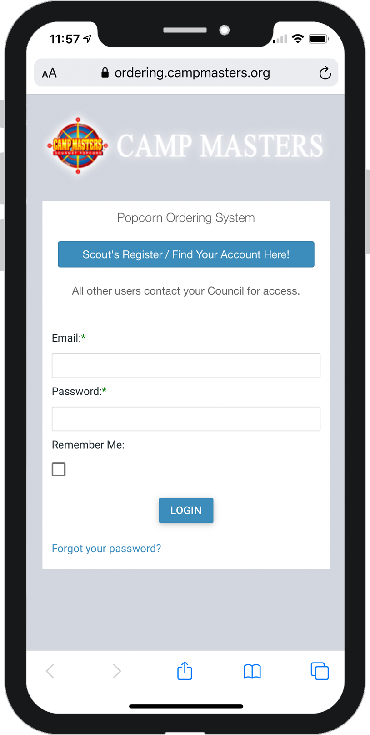
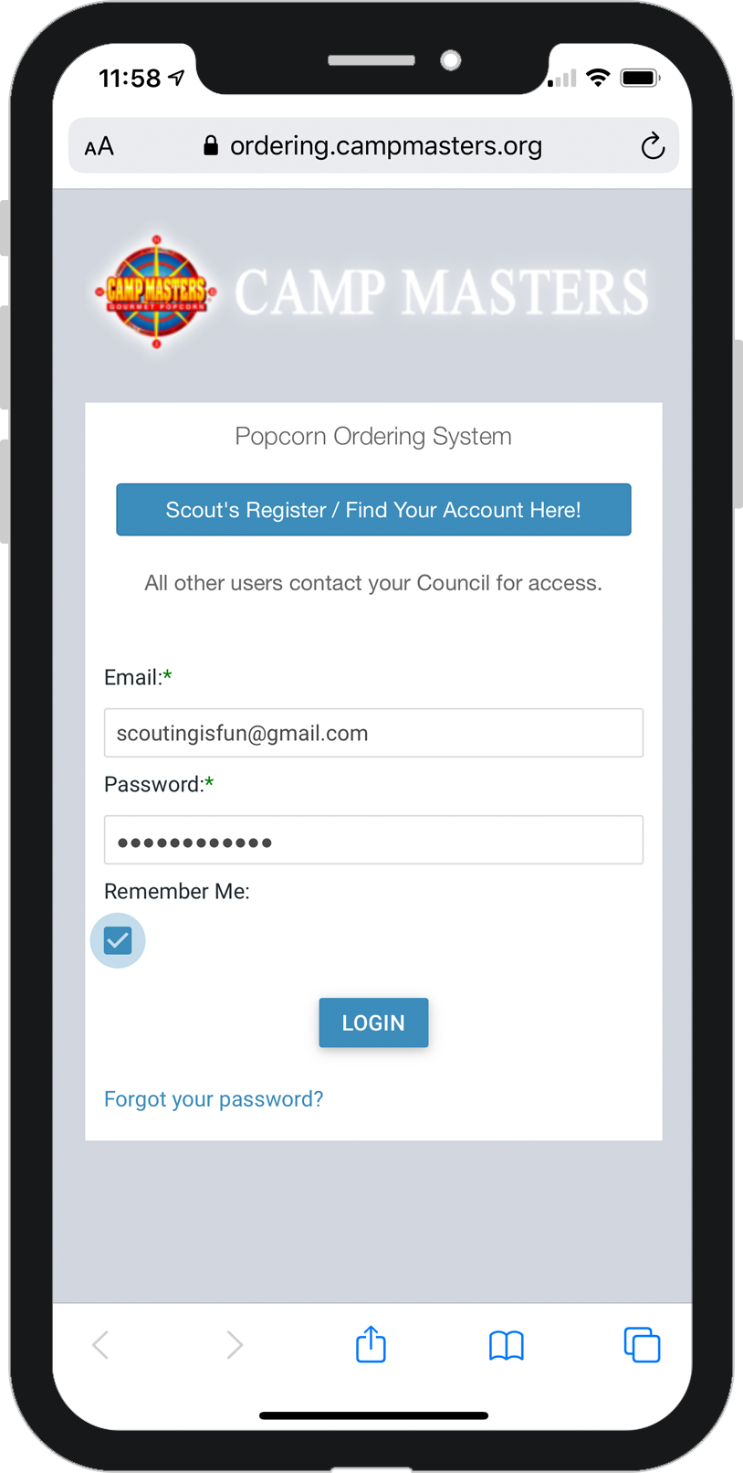
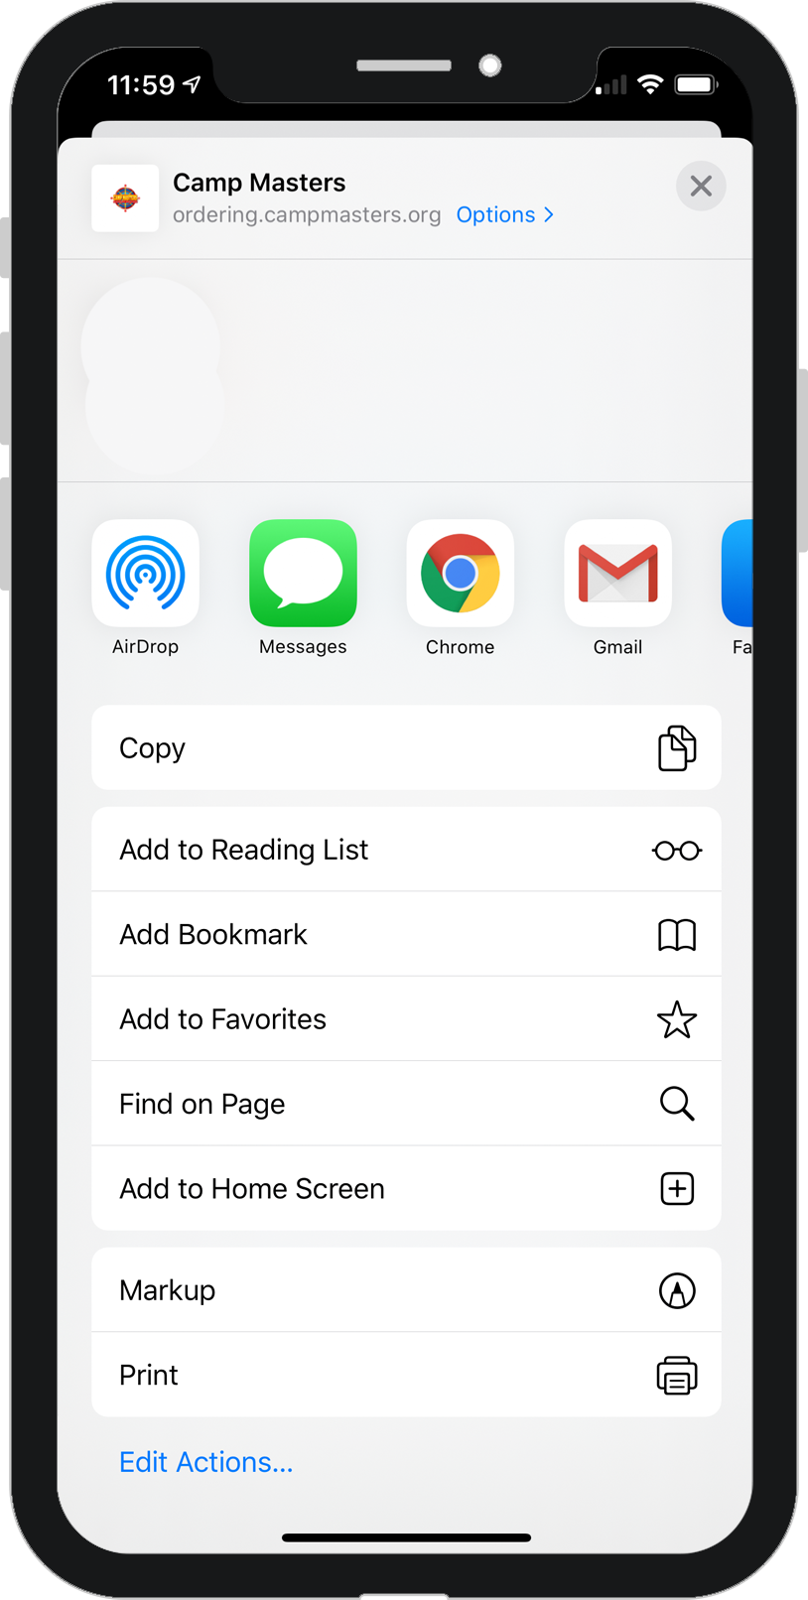
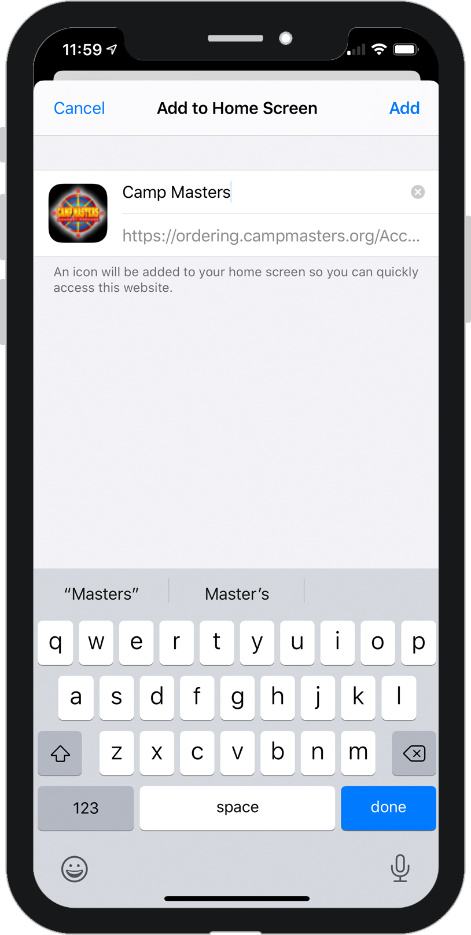

CAMP MASTERS APP
SCOUTS, PARENTS & LEADERS
Follow these instructions to easily create a CAMP MASTERS app icon on your smartphone.
Open Safari
Chrome on Android
Go to
ordering.campmasters.com/Account/Login
Enter your login and click “Remember Me” then Login
Once on your dashboard, click the menu button (circled icon above)
(3 dots in upper right on Android)
Select “Add to Home Screen”
Then click “Add”
Ready to sell? Click the icon!

Slide 25
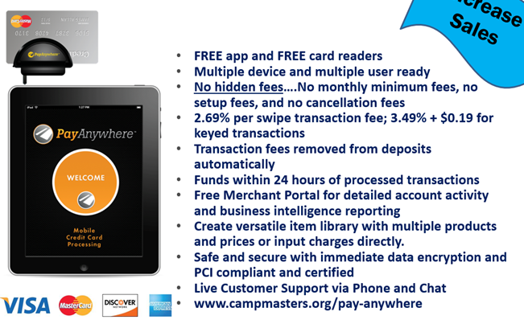
ACCEPTING CREDIT CARDS
CAMP MASTERS has partnered with PayAnywhere to provide accounts and free readers to all Units. Just go to: payanywhere.com/campmasters

Slide 26
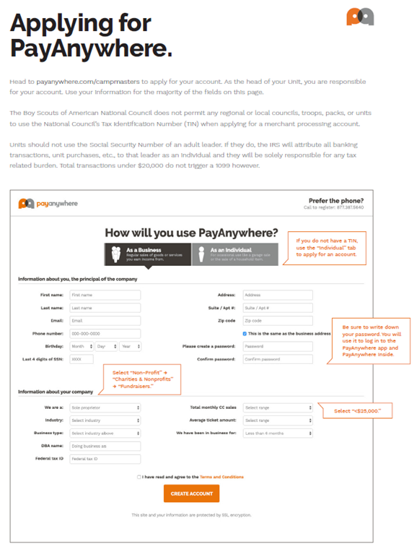
CREATE YOUR ACCOUNT

Slide 27
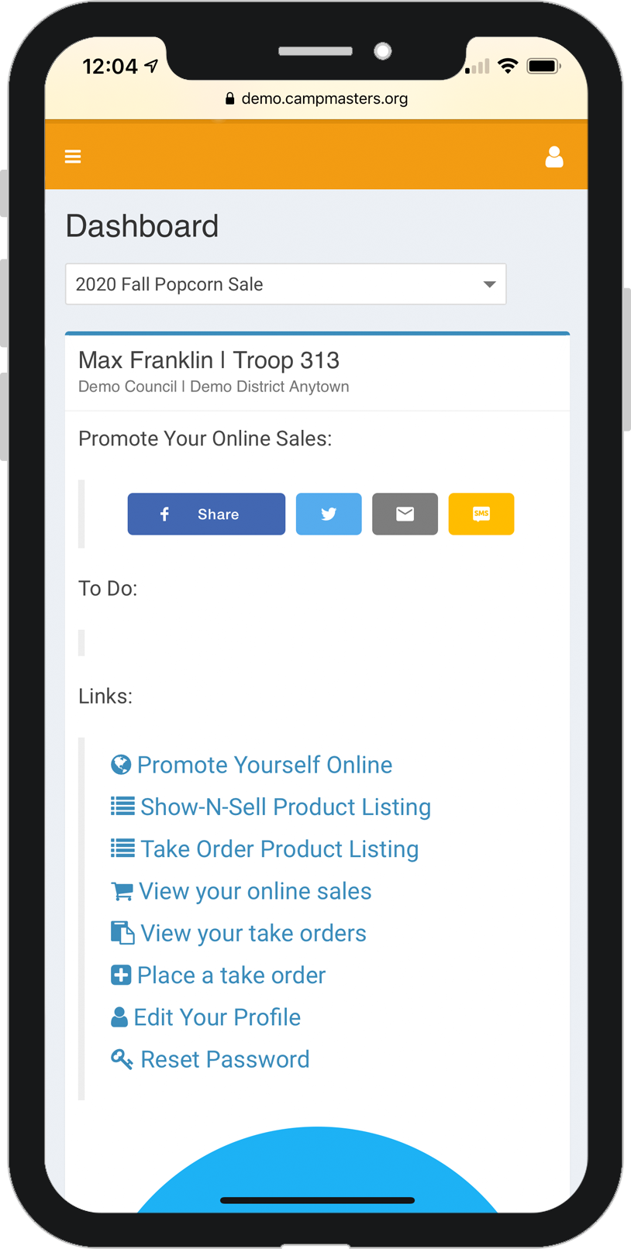
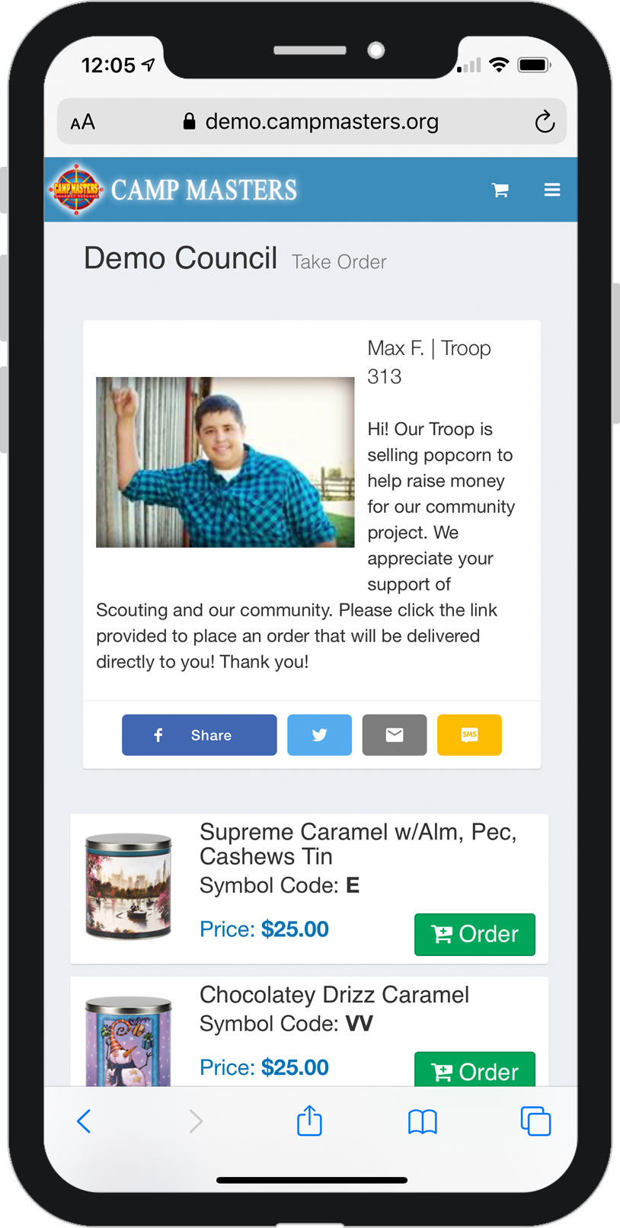
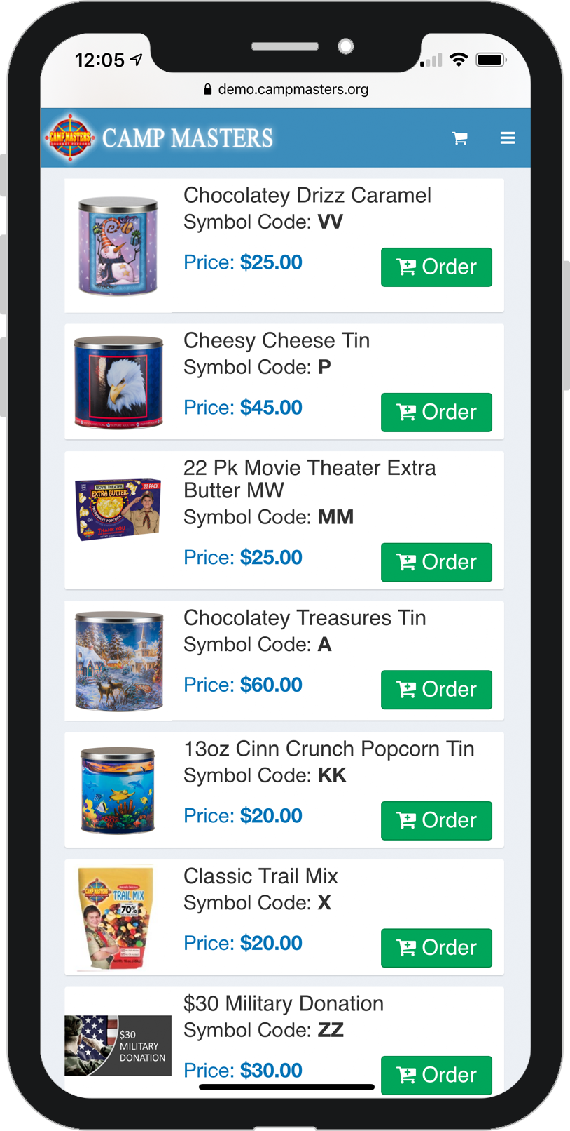
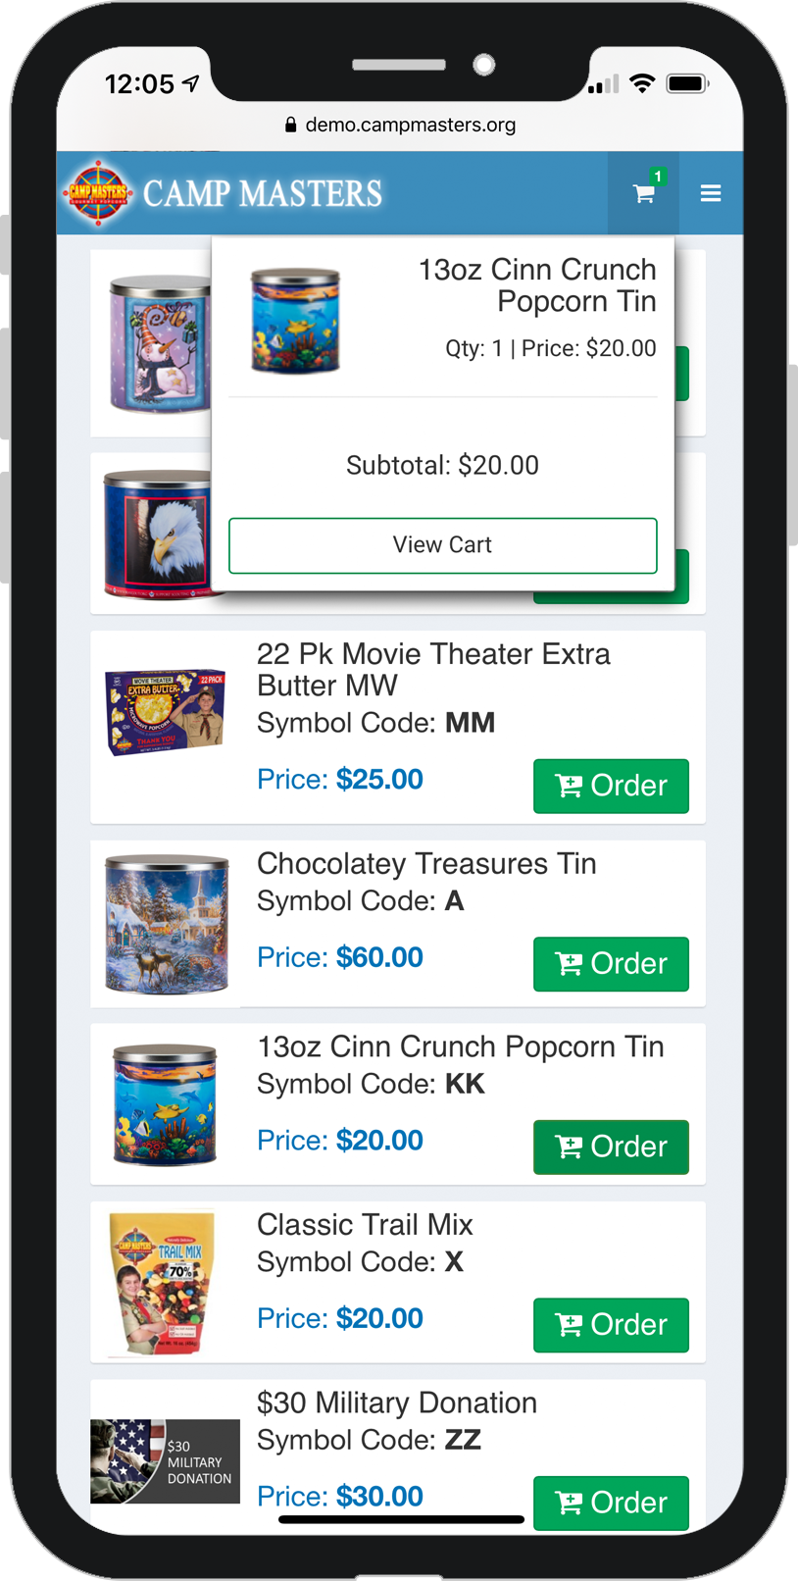
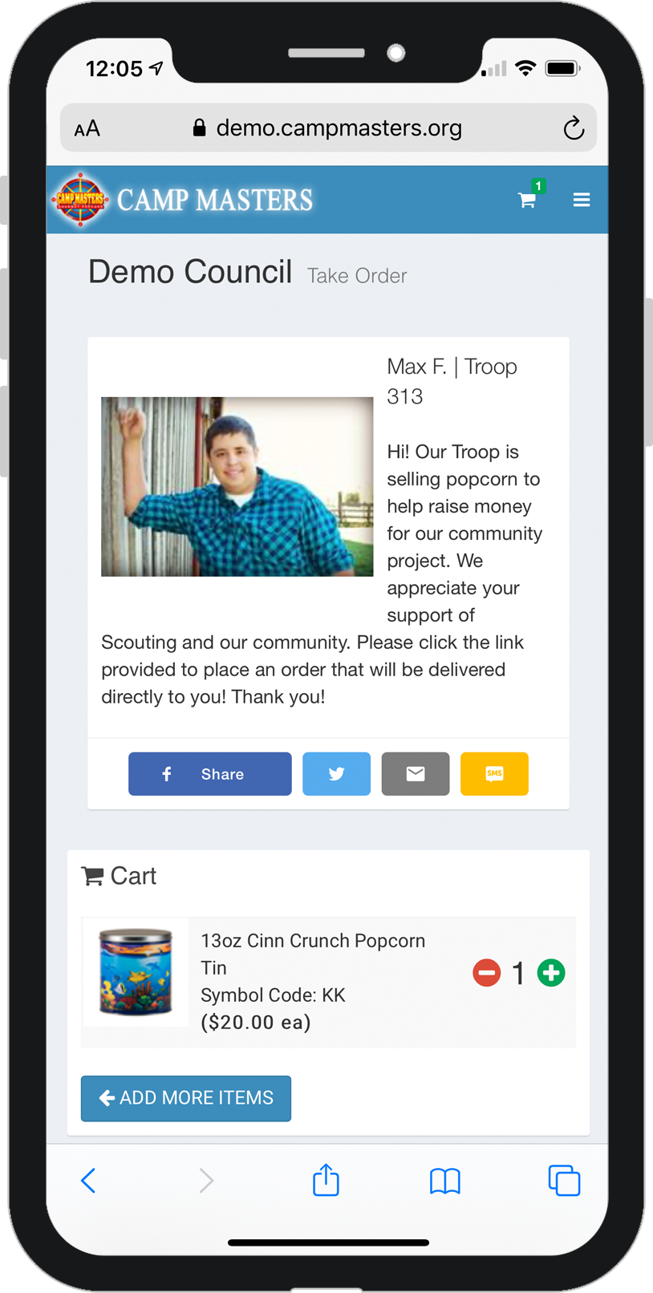
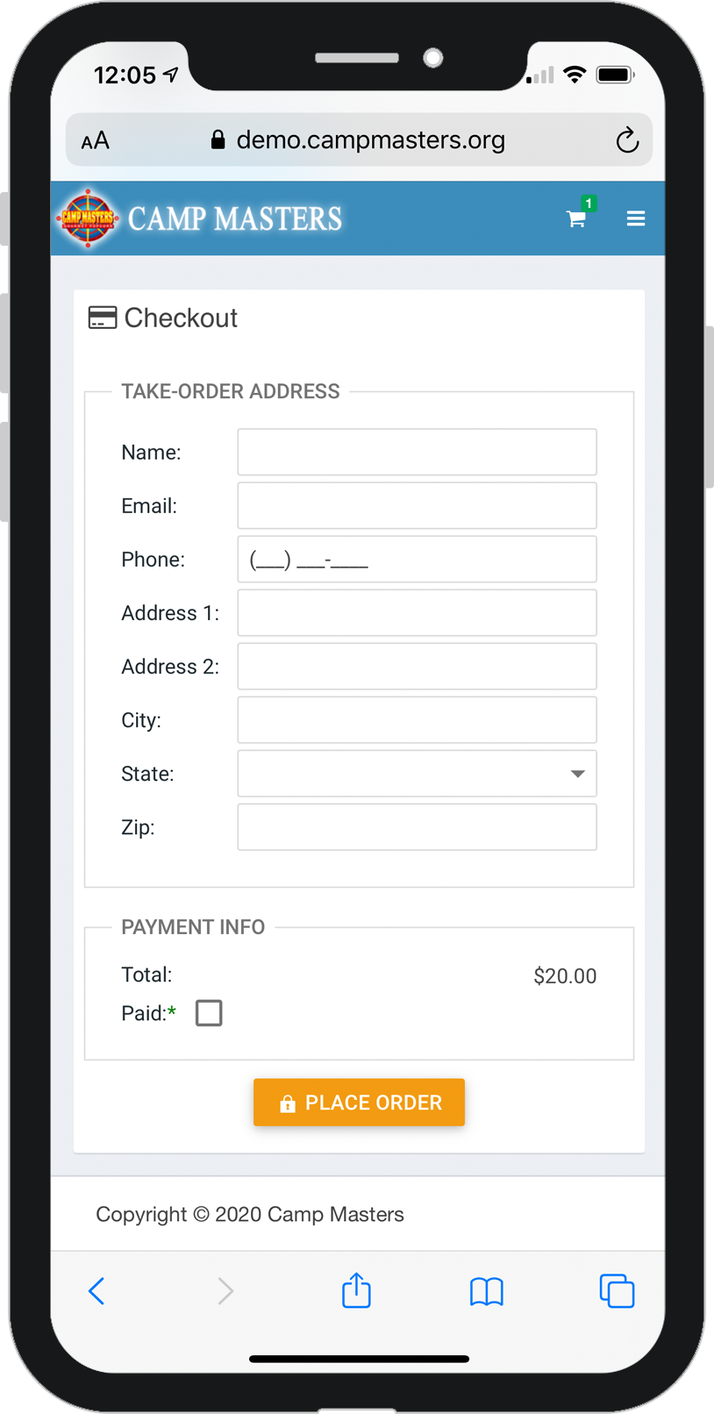
TAKE ORDERS ON THE GO
SCOUTS, PARENTS & LEADERS
Follow these instructions to easily take orders and payment on your smartphone.
Click “Place a Take Order” from the dashboard
This will take you to
the products page.
Scroll down to find the requested product. Then click “Order” to add the item to the shopping cart.
A confirmation window will appear. You can either go to cart or continue adding items.
In the cart, you can change the quantity of the product if needed.
Complete the customer
information.

Slide 28
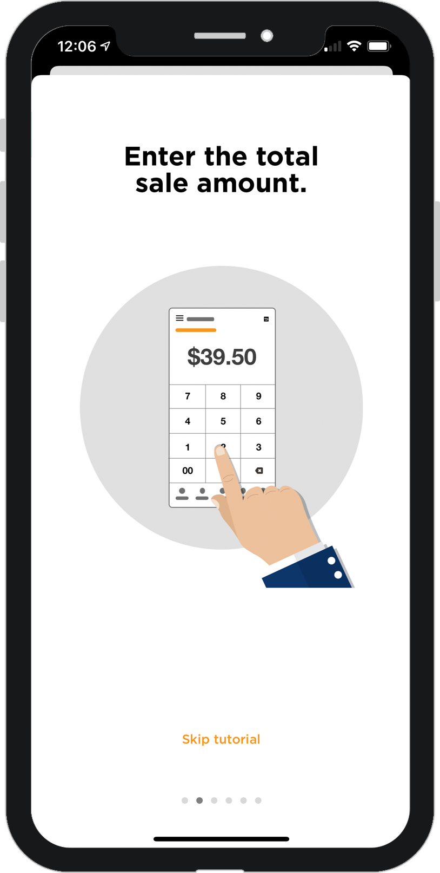
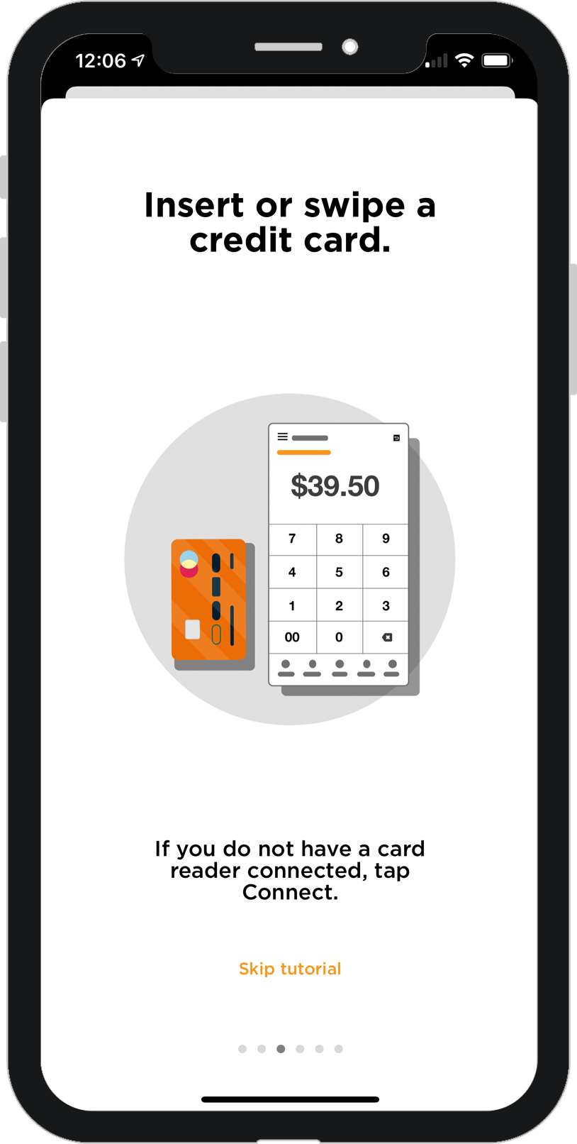
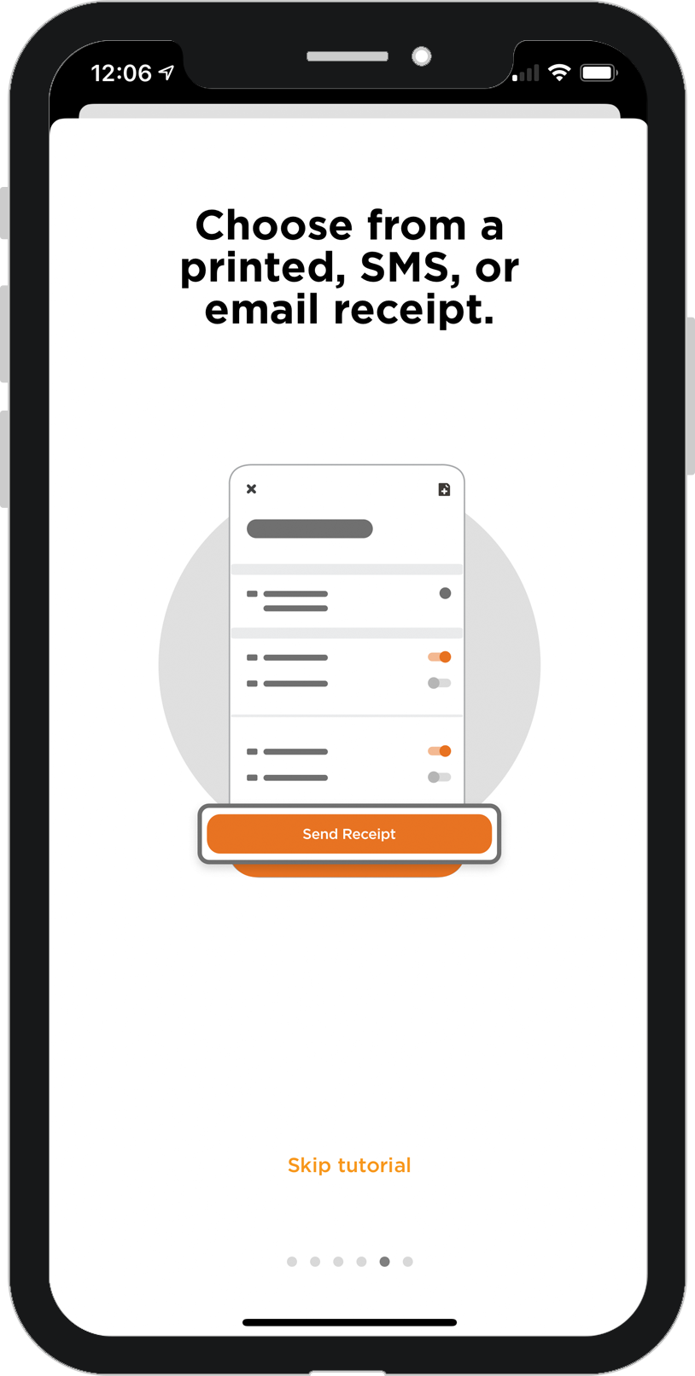
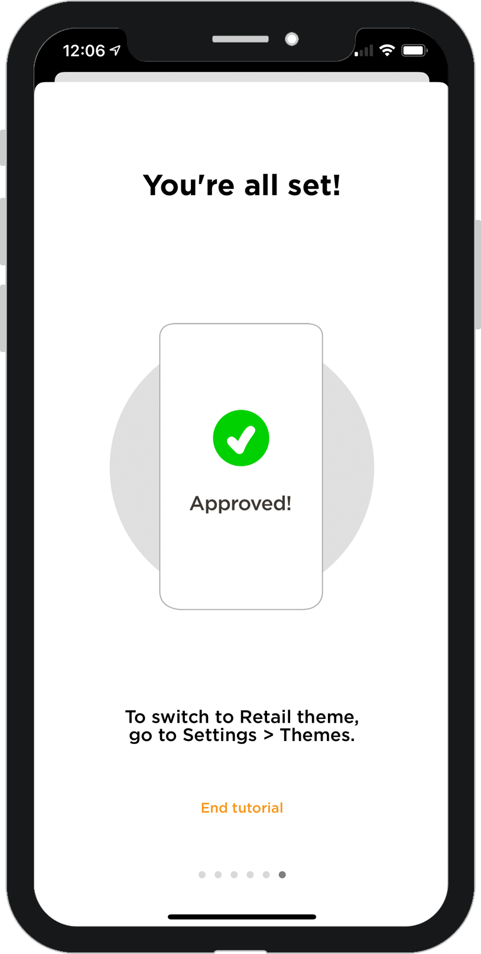
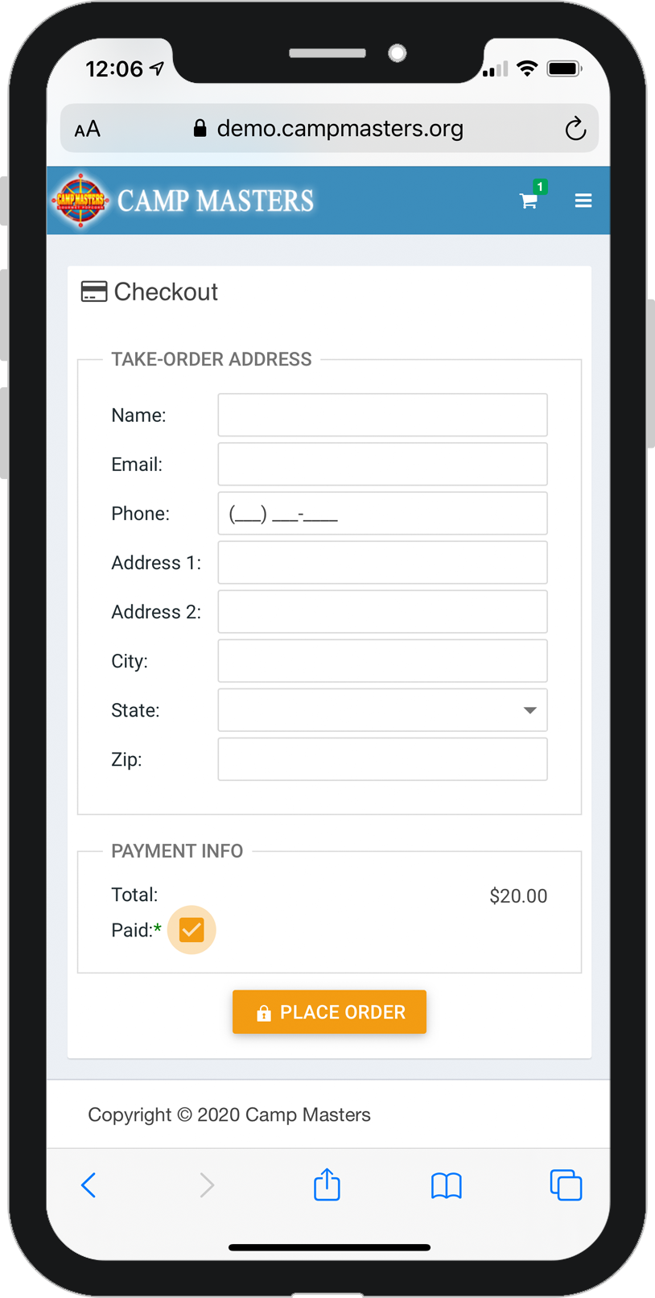
TAKE ORDERS ON THE GO
SCOUTS, PARENTS & LEADERS
Follow these instructions to easily take orders and payment on your smartphone.
Return to your home screen and open the PayAnywhere app.
Enter the total charge.
Insert or swipe the credit card depending on your reader type..
Offer the customer a SMS text or email reciept.
When you receive payment confirmation, return to CAMP MASTERS window.
Mark as paid and then tap the “Place Order” button.

Slide 29

INVENTORY & PAYMENTS
Remember
Show and Sell Inventory that is unsold and undamaged is due in the scout office by Monday, November 1, 2021, before Noon.
You can use your Show and Sell Inventory to fill your Take Orders before you place your Take Order.
Take Orders are Due by 4:00pm Monday, November 1, 2021
NO UNSOLD PRODUCT WILL BE ACCEPTED AFTER NOVEMER 1, 2021!
Take Order Payment should be in before product pick up on Wednesday, November 17, 2021.
Any Outstanding Balances – Payment Adjustments must be into the office no later than Wednesday, November 17, 2021.

Slide 30


WRAPPING UP YOUR SALE
As your popcorn sale is finishing up…
Have you turned in your youth that sold $750 or more to Lori at the scout office?
Have you placed your final order on the Campmasters Website (the one entry email you received at the beginning of the sale) no later than Monday, November 1 by 4:00pm? Remember the system will not let you enter sales in after that date.
Have you paid your popcorn invoice (minus your Commission) before November 17, 2021?
Have you placed your prize order?
  Remember we can not approve your prize order until you have paid your popcorn invoice.
  Don’t forget to order your patches and pins in that prize order for your scouts.
  LAST DAY TO PLACE PRIZE ORDERS IS DECEMBER 1, 2021
Thank You!

